Slide 1


ARTIFICIAL INTELLIGENCE
Unit-II: Advanced Search

Slide 2
Unit-II: Advanced Search
Constraint Satisfaction (Backtracking, Local Search)
Constructing Search Trees
Stochastic Search
A* Search Implementation
Minimax Search
Alpha-Beta Pruning

Slide 3
Constraint Satisfaction Problem (CSP)
states evaluated by heuristics and goal test conform to a standard, structured and simple representation
Constraint satisfaction problems or CSPs are mathematical problems where one must find states or objects that satisfy a number of constraints or criteria.
A constraint is a restriction of the feasible solutions in an optimization problem.

Slide 4
Constraint Satisfaction Problem (CSP)
CSP is a problem composed of a
finite set of variables,
each of which has a finite domain of values, and
a set of constraints
Each constraint is defined over some subset of the original set of variables and restricts the values these variables can simultaneously take.
The task is to find an assignment of a value for each variable such that the assignments satisfy all the constraints.

Slide 5
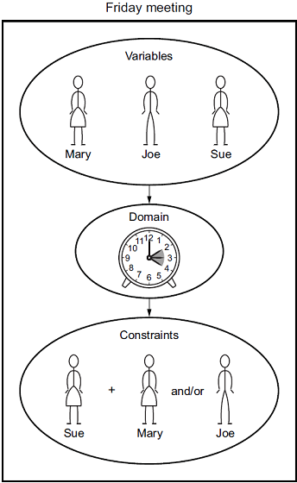
Examples
Example 1
Example 2
Different classrooms are of different capacity and an examination can only be scheduled in a classroom that has enough seats for students who are going to take that examination
Some students may take part in several examinations and these examinations can not be scheduled in the same time slot.

Slide 6
Constraint satisfaction problems
Finite set of variables V₁ , V₂ , …, V_{n}
Finite set of constrains C₁, C₂, …, C_{m}
Nonemtpy domain of possible values for each variable
D_{V1}, D_{V2}, … D_{Vn}
Each constraint C_{i} limits the values that variables can take, e.g., V₁ ≠ V₂
■
What is a CSP?
◻
◻
◻
◻
■
A state is defined as an assignment of values to some or all variables.
Consistent assignment: assignment does not violate the constraints.
■

Slide 7
Constraint satisfaction problems
■
An assignment is complete when every value is mentioned.
A solution to a CSP is a complete assignment that satisfies all constraints.
Some CSPs require a solution that maximizes an
objective function.
Applications: Scheduling the time of observations on the Hubble Space Telescope, Floor planning, Map coloring, Cryptography
■
■
■

Slide 8
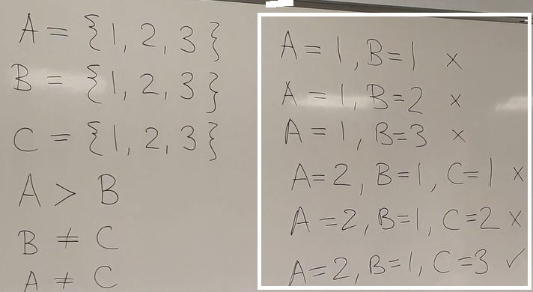
Constraint satisfaction problems

Slide 9
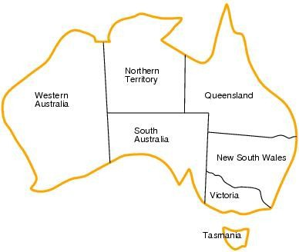
CSP example: map coloring
■
■
■
Variables: WA, NT, Q, NSW, V, SA, T
Domains: D_{i}={red,green,blue}
Constraints:adjacent regions must have different colors.
■
E.g. WA ≠ NT (if the language allows this)
E.g. (WA,NT) = {(red,green),(red,blue),(green,red),…}
■

Slide 10
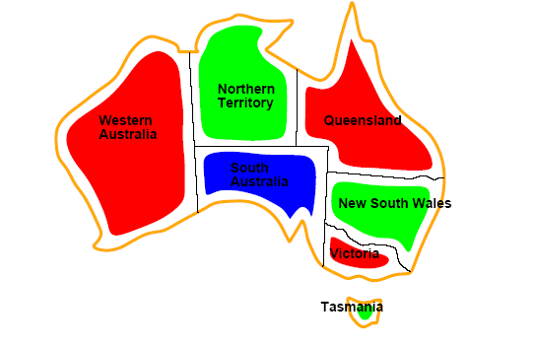
CSP example: map coloring
■
Solutions are assignments satisfying all constraints, e.g.
{WA=red,NT=green,Q=red,NSW=green,V=red,SA=blue,T=green}

Slide 11
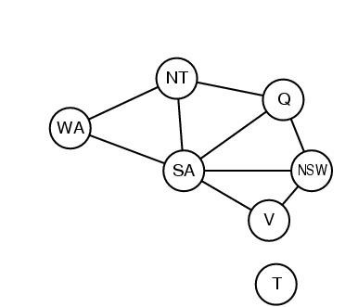
Constraint graph
■
CSP benefits
◻
◻
◻
Standard representation pattern Generic goal and successor functions
Generic heuristics (no domain specific expertise).
■
Constraint graph = nodes are variables, edges show constraints.
◻
Graph can be used to simplify search.
■
e.g. Tasmania is an independent subproblem.

Slide 12
Backtracking Search aka Brute-Force Search
It is similar to Depth-first search
Chooses values for one variable at a time and backtracks when a variable has no legal values left to assign.
Uninformed algorithm
No good general performance (see table p. 143)

Slide 13
Backtracking search
function BACKTRACKING-SEARCH(csp) return a solution or failure
return RECURSIVE-BACKTRACKING({} , csp)
function RECURSIVE-BACKTRACKING(assignment, csp) return a solution or failure
if assignment is complete then return assignment
var ← SELECT-UNASSIGNED-VARIABLE(VARIABLES[csp],assignment,csp)
for each value in ORDER-DOMAIN-VALUES(var, assignment, csp) do
if value is consistent with assignment according to CONSTRAINTS[csp] then
add {var=value} to assignment
result ← RRECURSIVE-BACTRACKING(assignment, csp)
if result ≠ failure then return result
remove {var=value} from assignment
return failure

Slide 14
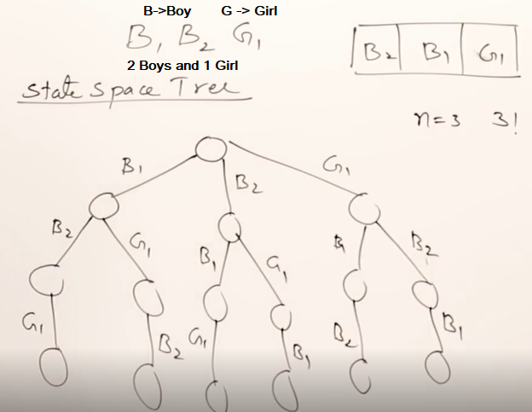
Backtracking search

Slide 15
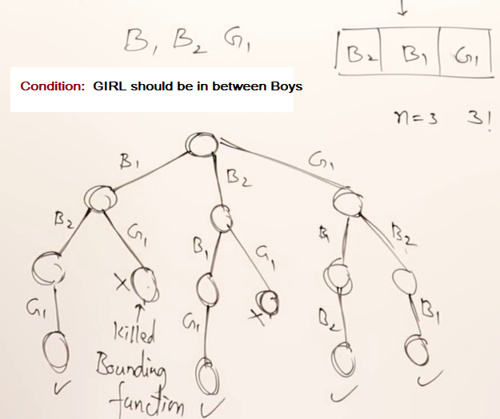
Backtracking search

Slide 16
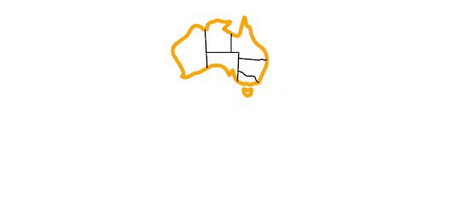
Backtracking example
Variables: WA, NT, Q, NSW, V, SA, T
Domains: D_{i}={red,green,blue}
Constraints:adjacent regions must have different colors.
E.g. WA ≠ NT (if the language allows this)
E.g. (WA,NT) = {(red,green),(red,blue),(green,red),…}

Slide 17
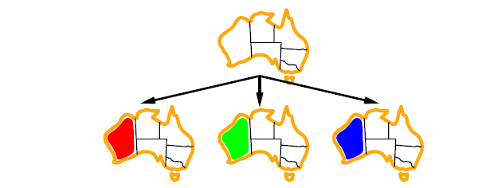
Backtracking example

Slide 18
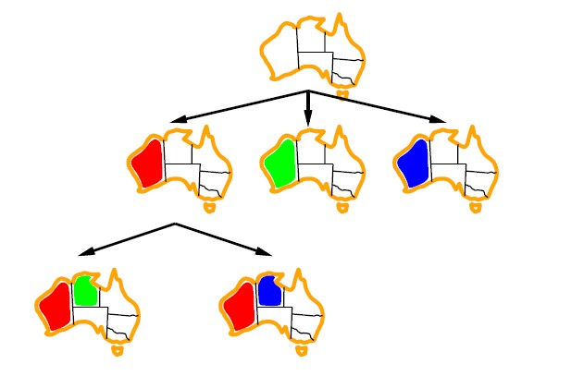
Backtracking example

Slide 19
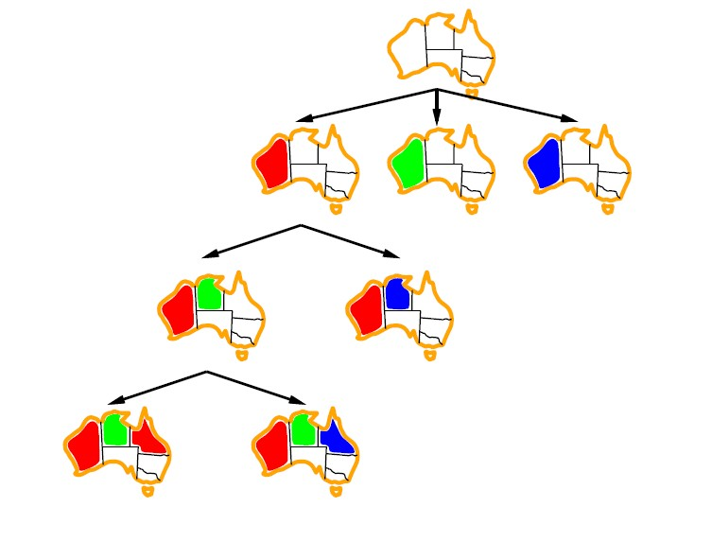
Backtracking example

Slide 20
Improving backtracking efficiency
Previous improvements → introduce heuristics
General-purpose methods can give huge gains in speed:
Which variable should be assigned next?
In what order should its values be tried?
Can we detect inevitable failure early?
Can we take advantage of problem structure?

Slide 21
Local Search
They apply mostly to problems for which we don't need to know the path to the solution but only the solution itself.
They operate using a single state or a small number of states and explore the neighbors of that state. They usually don't store the path.
A particular case are optimization problems for which we search for the best solution according to an objective function.
The distribution of values of the objective function in the state space is called a landscape.

Slide 22
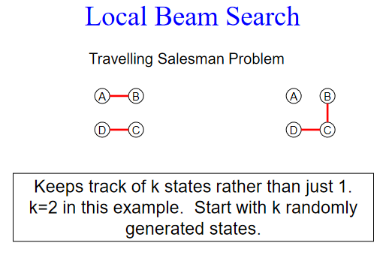
Local Beam Search
In this algorithm, it holds k number of states at any given time. At the start, these states are generated randomly.
The successors of these k states are computed with the help of objective function.
If any of these successors is the maximum value of the objective function, then the algorithm stops.
Otherwise the (initial k states and k number of successors of the states = 2k) states are
placed in a pool.
The pool is then sorted numerically.
The highest k states are selected as
New initial states.
This process continues until
a maximum value is reached.

Slide 23
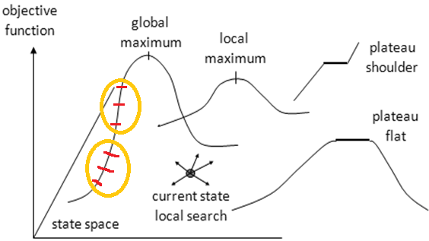
Local Search
Global maximum - a state that maximizes the objective function over the entire landscape.
Local maximum - a state that maximizes the objective function in a small area around it.
Plateau - a state such that the objective function is constant in an area around it.
Shoulder - a plateau that has an uphill edge.

Slide 24
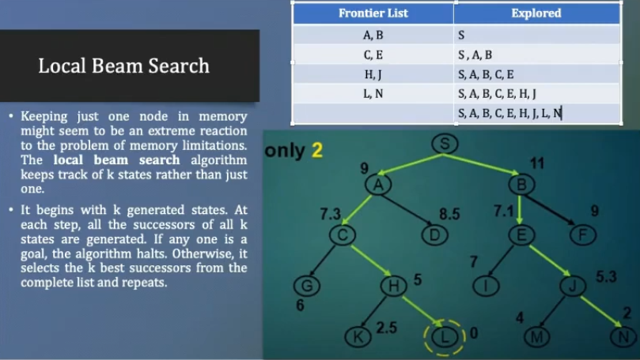
Local Search

Slide 25
Constructing Search Trees
Search: Searching is a step by step procedure to solve a search-problem in a given search space.
Search tree: A tree representation of search problem is called Search tree. The root of the search tree is the root node which is corresponding to the initial state.
A search problem consists of:
A State Space. Set of all possible states where you can be.
A Start State. The state from where the search begins.
A Goal Test. A function that looks at the current state returns whether or not it is the goal state.

Slide 26
Constructing Search Trees
Create search trees to solve Artificial Intelligence questions.
Use each piece of information as a node and construct a hierarchy of nodes based on how the individual pieces of information connect together so that one can go along a path through a series of nodes in order to get from one to another.
The search tree will find a potential solution to unknown questions by looking at the available data in an organized manner, one piece (or "node") at a time.

Slide 27
Constructing Search Trees
Suppose one is writing a program for an airline to find a way for a customer to get from City A to City B given a list of all of the possible flights between any two cities. The program will need to go through the list and determine which flight (or connecting series of flights) that the customer should take. This is implemented using a search tree.
City A (where the customer currently is located) will be the initial piece of information, or "initial node." The search tree will consist of this initial node at the top of the tree.
Next, the program would look at all of the flights beginning with City A. These flights would show cities that the customer could reach in just one flight, and so these cities (each city a node itself) are on the next level, below the initial node.
Now, each of these cities has flights as well, which would be on the third level, and the tree would continue so forth.

Slide 28
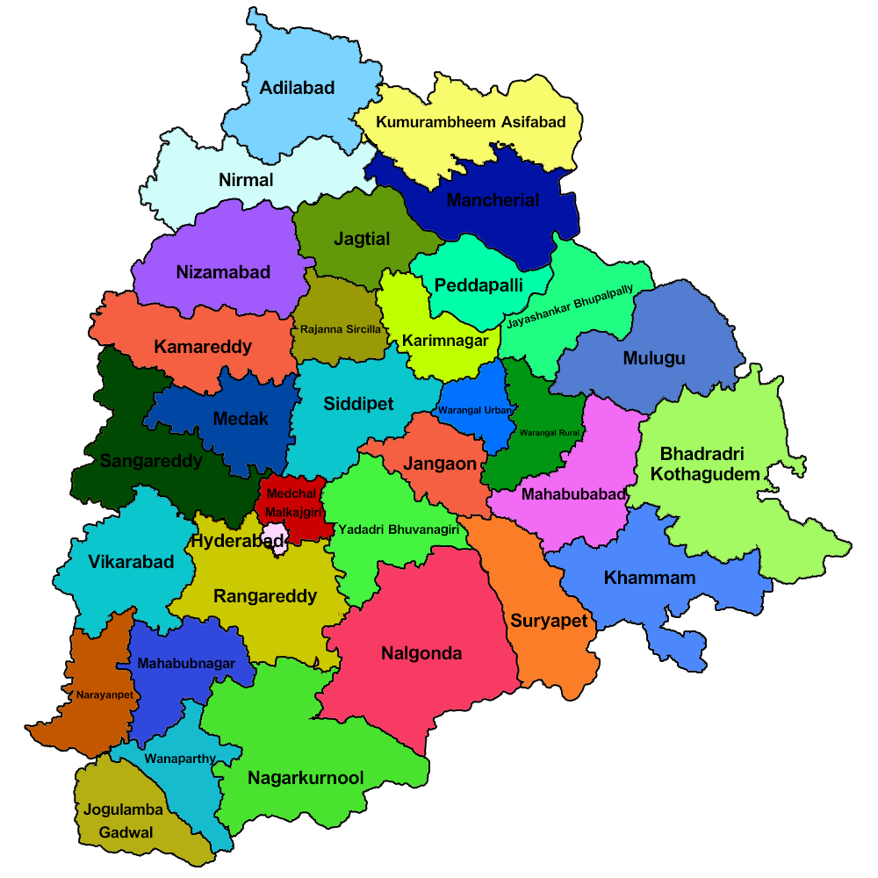
Constructing Search Trees
Choosing a search strategy (i.e. Breadth-first or Depth-first) will tell the program how to progress down the search tree, or hierarchy of nodes that has been built from the information. There are clearly many different ways that one can get from City A to City B, so the search strategy is the key to determining which path will be selected.
Search trees, with search strategies, can also be found in finding solutions in puzzle-solving or simple games such as "The Eight Queens Problem" where one tries to place eight queens in locations on a chessboard such that none of them can move to the space of another.

Slide 29
Stochastic Search
Stochastic search is one of the hill climbing search algorithms, that does not examine for all its neighbor before moving.
Rather, this search algorithm selects one neighbor node at random and decides whether to choose it as a current state or examine another state.
Under a stochastic beam search it is possible for an individual to be selected multiple times at random.

Slide 30
Stochastic Search
Stochastic pretty much means randomized in some way.
One of the major issues with beam search is that it tends to get stuck into local optima instead of the global optimum.
To avoid that stochastic search gives some(most often small) probability of the solution to choose the step that is not optimal at a given moment.

Slide 31
Stochastic Beam Search
In the Stochastic beam search instead of choosing the best k individuals, it selects k number of the individuals at random; the individuals with a better evaluation are more likely to be chosen. This is done by making the probability of being chosen as a function of the evaluation function.
Stochastic beam search tends to allow more diversity in the k individuals than does plain beam search.
In terms of evolution in biology, the evaluation function reflects the fitness of the individual; the fitter the individual, the more likely it is to pass that part of its variable task that is good over the next generation.
Stochastic beam search is similar to asexual reproduction within which every individual offers slightly mutated children and then stochastic beam search proceeds with the survival of the fittest.

Slide 32
Mini-max Search
Mini-max algorithm is a recursive or backtracking algorithm which is used in decision-making and game theory.
It provides an optimal move for the player assuming that opponent is also playing optimally.
Mini-Max algorithm uses recursion to search through the game-tree.
Min-Max algorithm is mostly used for game playing in AI. Such as Chess, Checkers, tic-tac-toe, go, and various tow-players game. This Algorithm computes the minimax decision for the current state.

Slide 33
Mini-max Search
In this algorithm two players play the game, one is called MAX and other is called MIN. Both the players fight it as the opponent player gets the minimum benefit while they get the maximum benefit.
Both Players of the game are opponent of each other, where MAX will select the maximized value and MIN will select the minimized value.
The minimax algorithm performs a depth-first search algorithm for the exploration of the complete game tree.
The minimax algorithm proceeds all the way down to the terminal node of the tree, then backtrack the tree as the recursion.

Slide 34
Mini-max Search: Psedo Code
function minimax(node, depth, maximizingPlayer) is
if depth ==0 or node is a terminal node then
return static evaluation of node
if MaximizingPlayer then // for Maximizer Player
maxEva= -infinity
for each child of node do
eva= minimax(child, depth-1, false)
maxEva= max(maxEva,eva) //gives Maximum of the values
return maxEva
else // for Minimizer player
minEva= +infinity
for each child of node do
eva= minimax(child, depth-1, true)
minEva= min(minEva, eva) //gives minimum of the values
return minEva

Slide 35
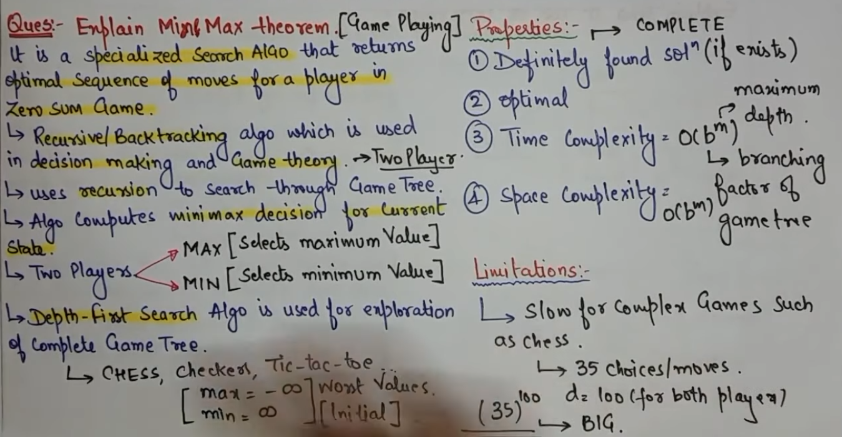

Slide 36
Working of Mini-max Search
The working of the minimax algorithm can be easily described using an example. Below we have taken an example of game-tree which is representing the two-player game.
In this example, there are two players one is called Maximizer and other is called Minimizer.
Maximizer will try to get the Maximum possible score, and Minimizer will try to get the minimum possible score.
This algorithm applies DFS, so in this game-tree, we have to go all the way through the leaves to reach the terminal nodes.
At the terminal node, the terminal values are given so we will compare those value and backtrack the tree until the initial state occurs. Following are the main steps involved in solving the two-player game tree:

Slide 37
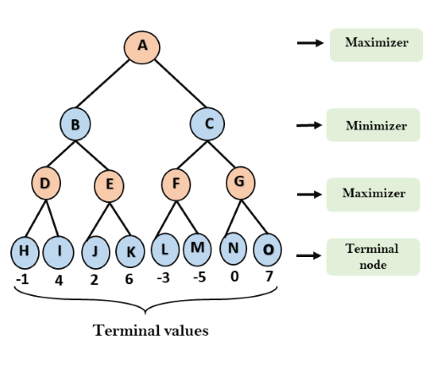
Working of Mini-max Search
Step-1: In the first step, the algorithm generates the entire game-tree and apply the utility function to get the utility values for the terminal states.
In the below tree diagram, let's take A is the initial state of the tree.
Suppose maximizer takes first turn which has worst-case initial value =- infinity,
and minimizer will take next turn which has worst-case initial value = +infinity

Slide 38
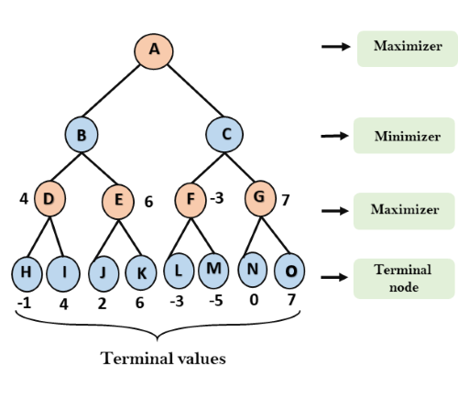
Working of Mini-max Search
Step 2: Now, first we find the utilities value for the Maximizer, its initial value is -∞, so we will compare each value in terminal state with initial value of Maximizer and determines the higher nodes values. It will find the maximum among the all.
For node D max(-1,- -∞) => max(-1,4)= 4
For Node E max(2, -∞) => max(2, 6)= 6
For Node F max(-3, -∞) => max(-3,-5) = -3
For node G max(0, -∞) = max(0, 7) = 7

Slide 39
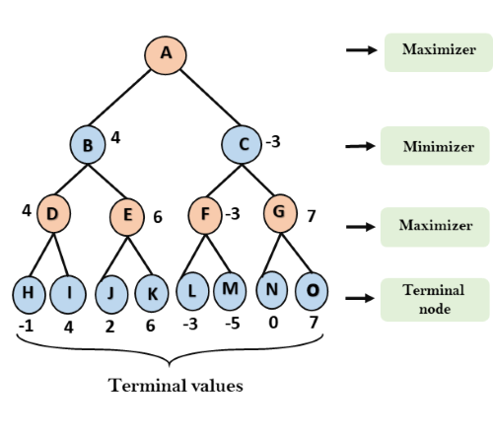
Working of Mini-max Search
Step 3: In the next step, it's a turn for minimizer, so it will compare all nodes value with +∞, and will find the 3rd layer node values.
For node B= min(4,6) = 4
For node C= min (-3, 7) =
-3

Slide 40
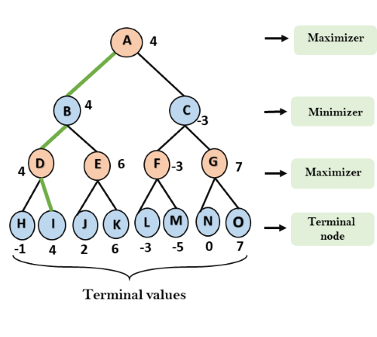
Working of Mini-max Search
Step 4: Now it's a turn for Maximizer, and it will again choose the maximum of all nodes value and find the maximum value for the root node.
In this game tree, there are only 4 layers, hence we reach immediately to the root node, but in real games, there will be more than 4 layers.
For node A max(4, -3)= 4

Slide 41
Limitation of the Mini-max Search
The main drawback of the minimax algorithm is that it gets really slow for complex games such as Chess, go, etc. This type of games has a huge branching factor, and the player has lots of choices to decide.
This limitation of the minimax algorithm can be improved from alpha-beta pruning which we have discussed in the next topic.

Slide 42
Alpha-Beta Pruning
Alpha-beta pruning is a modified version of the minimax algorithm. It is an optimization technique for the minimax algorithm.
As we have seen in the minimax search algorithm that the number of game states it has to examine are exponential in depth of the tree. Since we cannot eliminate the exponent, but we can cut it to half.
Hence there is a technique by which without checking each node of the game tree we can compute the correct minimax decision, and this technique is called pruning.
This involves two threshold parameter Alpha and beta for future expansion, so it is called alpha-beta pruning. It is also called as Alpha-Beta Algorithm.

Slide 43
Alpha-Beta Pruning
Alpha-beta pruning can be applied at any depth of a tree, and sometimes it not only prune the tree leaves but also entire sub-tree.
The two-parameter can be defined as: Alpha: The best (highest-value) choice we have found so far at any point along the path of Maximizer. The initial value of alpha is -∞.
Beta: The best (lowest-value) choice we have found so far at any point along the path of Minimizer. The initial value of beta is +∞.

Slide 44
Alpha-Beta Pruning
The Alpha-beta pruning to a standard minimax algorithm returns the same move as the standard algorithm does, but it removes all the nodes which are not really affecting the final decision but making algorithm slow. Hence by pruning these nodes, it makes the algorithm fast.

Slide 45
Condition for Alpha-Beta Pruning
The main condition which required for alpha-beta pruning is:
α>=β
Key points about alpha-beta pruning:
The Max player will only update the value of alpha.
The Min player will only update the value of beta.
While backtracking the tree, the node values will be passed to upper nodes instead of values of alpha and beta.
We will only pass the alpha, beta values to the child nodes.

Slide 46
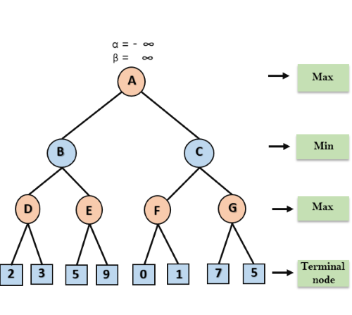
Working of Alpha-Beta Pruning
Let's take an example of two-player search tree to understand the working of Alpha-beta pruning
Step 1: At the first step the, Max player will start first move from node A where α= -∞ and β= +∞, these value of alpha and beta passed down to node B where again α= -∞ and β= +∞, and Node B passes the same value to its child D.

Slide 47
Working of Alpha-Beta Pruning
Step 2: At Node D, the value of α will be calculated as its turn for Max. The value of α is compared with firstly 2 and then 3, and the max (2, 3) = 3 will be the value of α at node D and node value will also 3.
Step 3: Now algorithm backtrack to node B, where the value of β will change as this is a turn of Min, Now β= +∞, will compare with the available subsequent nodes value, i.e. min (∞, 3) = 3, hence at node B now α= -∞, and β= 3.
In the next step, algorithm traverse the next successor of Node B which is node E, and the values of α= -∞, and β= 3 will also be passed.

Slide 48
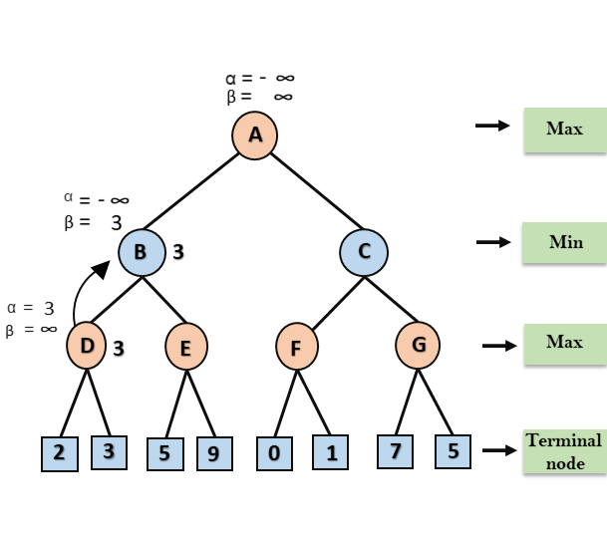
Working of Alpha-Beta Pruning
Step 4: At node E, Max will take its turn, and the value of alpha will change. The current value of alpha will be compared with 5, so max (-∞, 5) = 5, hence at node E α= 5 and β= 3, where α>=β, so the right successor of E will be pruned, and algorithm will not traverse it, and the value at node E will be 5.

Slide 49
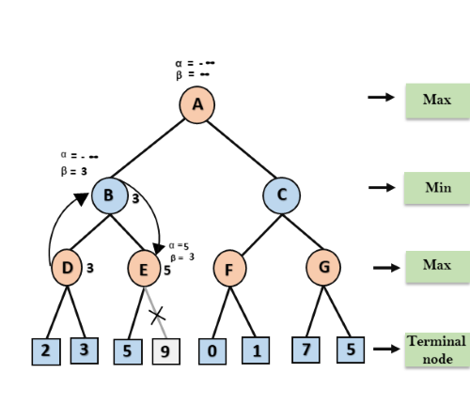
Working of Alpha-Beta Pruning
Step 5: At next step, algorithm again backtrack the tree, from node B to node A. At node A, the value of alpha will be changed the maximum available value is 3 as max (-∞, 3)= 3, and β= +∞, these two values now passes to right successor of A which is Node C.
At node C, α=3 and β= +∞, and the same values will be passed on to node F.

Slide 50
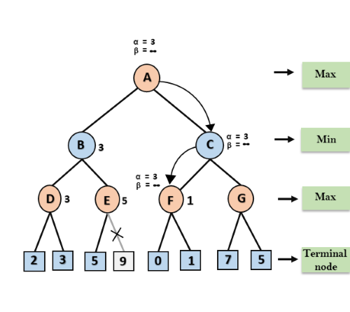
Working of Alpha-Beta Pruning
Step 6: At node F, again the value of α will be compared with left child which is 0, and max(3,0)= 3, and then compared with right child which is 1, and max(3,1)= 3 still α remains 3, but the node value of F will become 1.

Slide 51
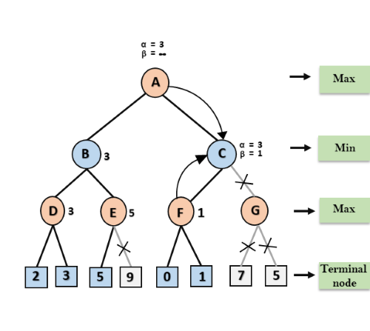
Working of Alpha-Beta Pruning
Step 7: Node F returns the node value 1 to node C, at C α= 3 and β= +∞, here the value of beta will be changed, it will compare with 1 so min (∞, 1) = 1. Now at C, α=3 and β= 1, and again it satisfies the condition α>=β, so the next child of C which is G will be pruned, and the algorithm will not compute the entire sub-tree G.

Slide 52
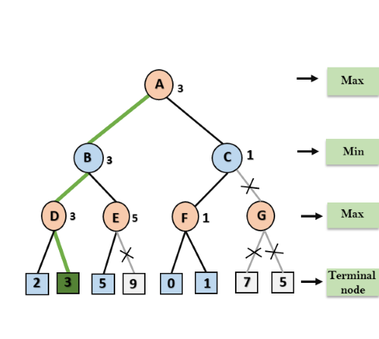
Working of Alpha-Beta Pruning
Step 8: C now returns the value of 1 to A here the best value for A is max (3, 1) = 3. Following is the final game tree which is the showing the nodes which are computed and nodes which has never computed. Hence the optimal value for the maximizer is 3 for this example.

Slide 53
Move Ordering in Alpha-Beta pruning:
The effectiveness of alpha-beta pruning is highly dependent on the order in which each node is examined. Move order is an important aspect of alpha-beta pruning.
It can be of two types:
Worst ordering: In some cases, alpha-beta pruning algorithm does not prune any of the leaves of the tree, and works exactly as minimax algorithm. In this case, it also consumes more time because of alpha-beta factors, such a move of pruning is called worst ordering. In this case, the best move occurs on the right side of the tree. The time complexity for such an order is O(b^{m}).
Ideal ordering: The ideal ordering for alpha-beta pruning occurs when lots of pruning happens in the tree, and best moves occur at the left side of the tree. We apply DFS hence it first search left of the tree and go deep twice as minimax algorithm in the same amount of time. Complexity in ideal ordering is O(b^{m/2}).

